Slide 1
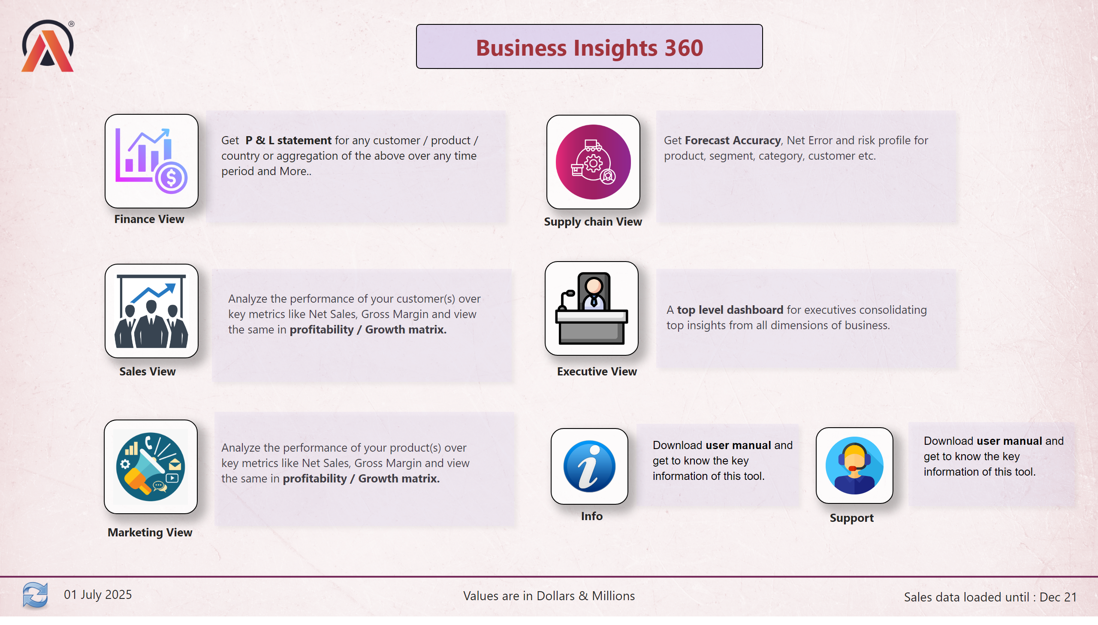
Home
Notes:
image
No alt text provided
textbox
No alt text provided
card
No alt text provided
textbox
No alt text provided
card
No alt text provided
shape
No alt text provided
image
No alt text provided
image
No alt text provided
image
No alt text provided
image
No alt text provided
image
No alt text provided
image
No alt text provided
image
No alt text provided
image
No alt text provided
shape
No alt text provided
shape
No alt text provided
textbox
No alt text provided
textbox
No alt text provided
textbox
No alt text provided
textbox
No alt text provided
textbox
No alt text provided
textbox
No alt text provided
textbox
No alt text provided
textbox
No alt text provided
textbox
No alt text provided
textbox
No alt text provided
textbox
No alt text provided
textbox
No alt text provided
textbox
No alt text provided
textbox
No alt text provided
shape
No alt text provided
shape
No alt text provided
shape
No alt text provided
shape
No alt text provided
shape
No alt text provided

Slide 2
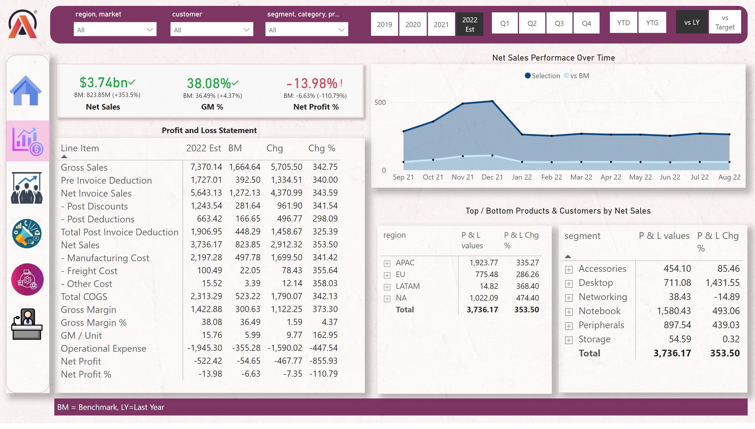
Finance View
Notes:
pivotTable
No alt text provided
slicer
No alt text provided
slicer
No alt text provided
slicer
No alt text provided
Net Sales Performace Over Time
No alt text provided
pivotTable
No alt text provided
pivotTable
No alt text provided
card
No alt text provided
card
No alt text provided
textbox
No alt text provided
slicer
No alt text provided
slicer
No alt text provided
slicer
No alt text provided
kpi
No alt text provided
textbox
No alt text provided
kpi
No alt text provided
textbox
No alt text provided
kpi
No alt text provided
textbox
No alt text provided
image
No alt text provided
shape
No alt text provided
shape
No alt text provided
textbox
No alt text provided
slicer
No alt text provided
card
No alt text provided
shape
No alt text provided
shape
No alt text provided
image
No alt text provided
image
No alt text provided
image
No alt text provided
image
No alt text provided
image
No alt text provided
image
No alt text provided

Slide 3
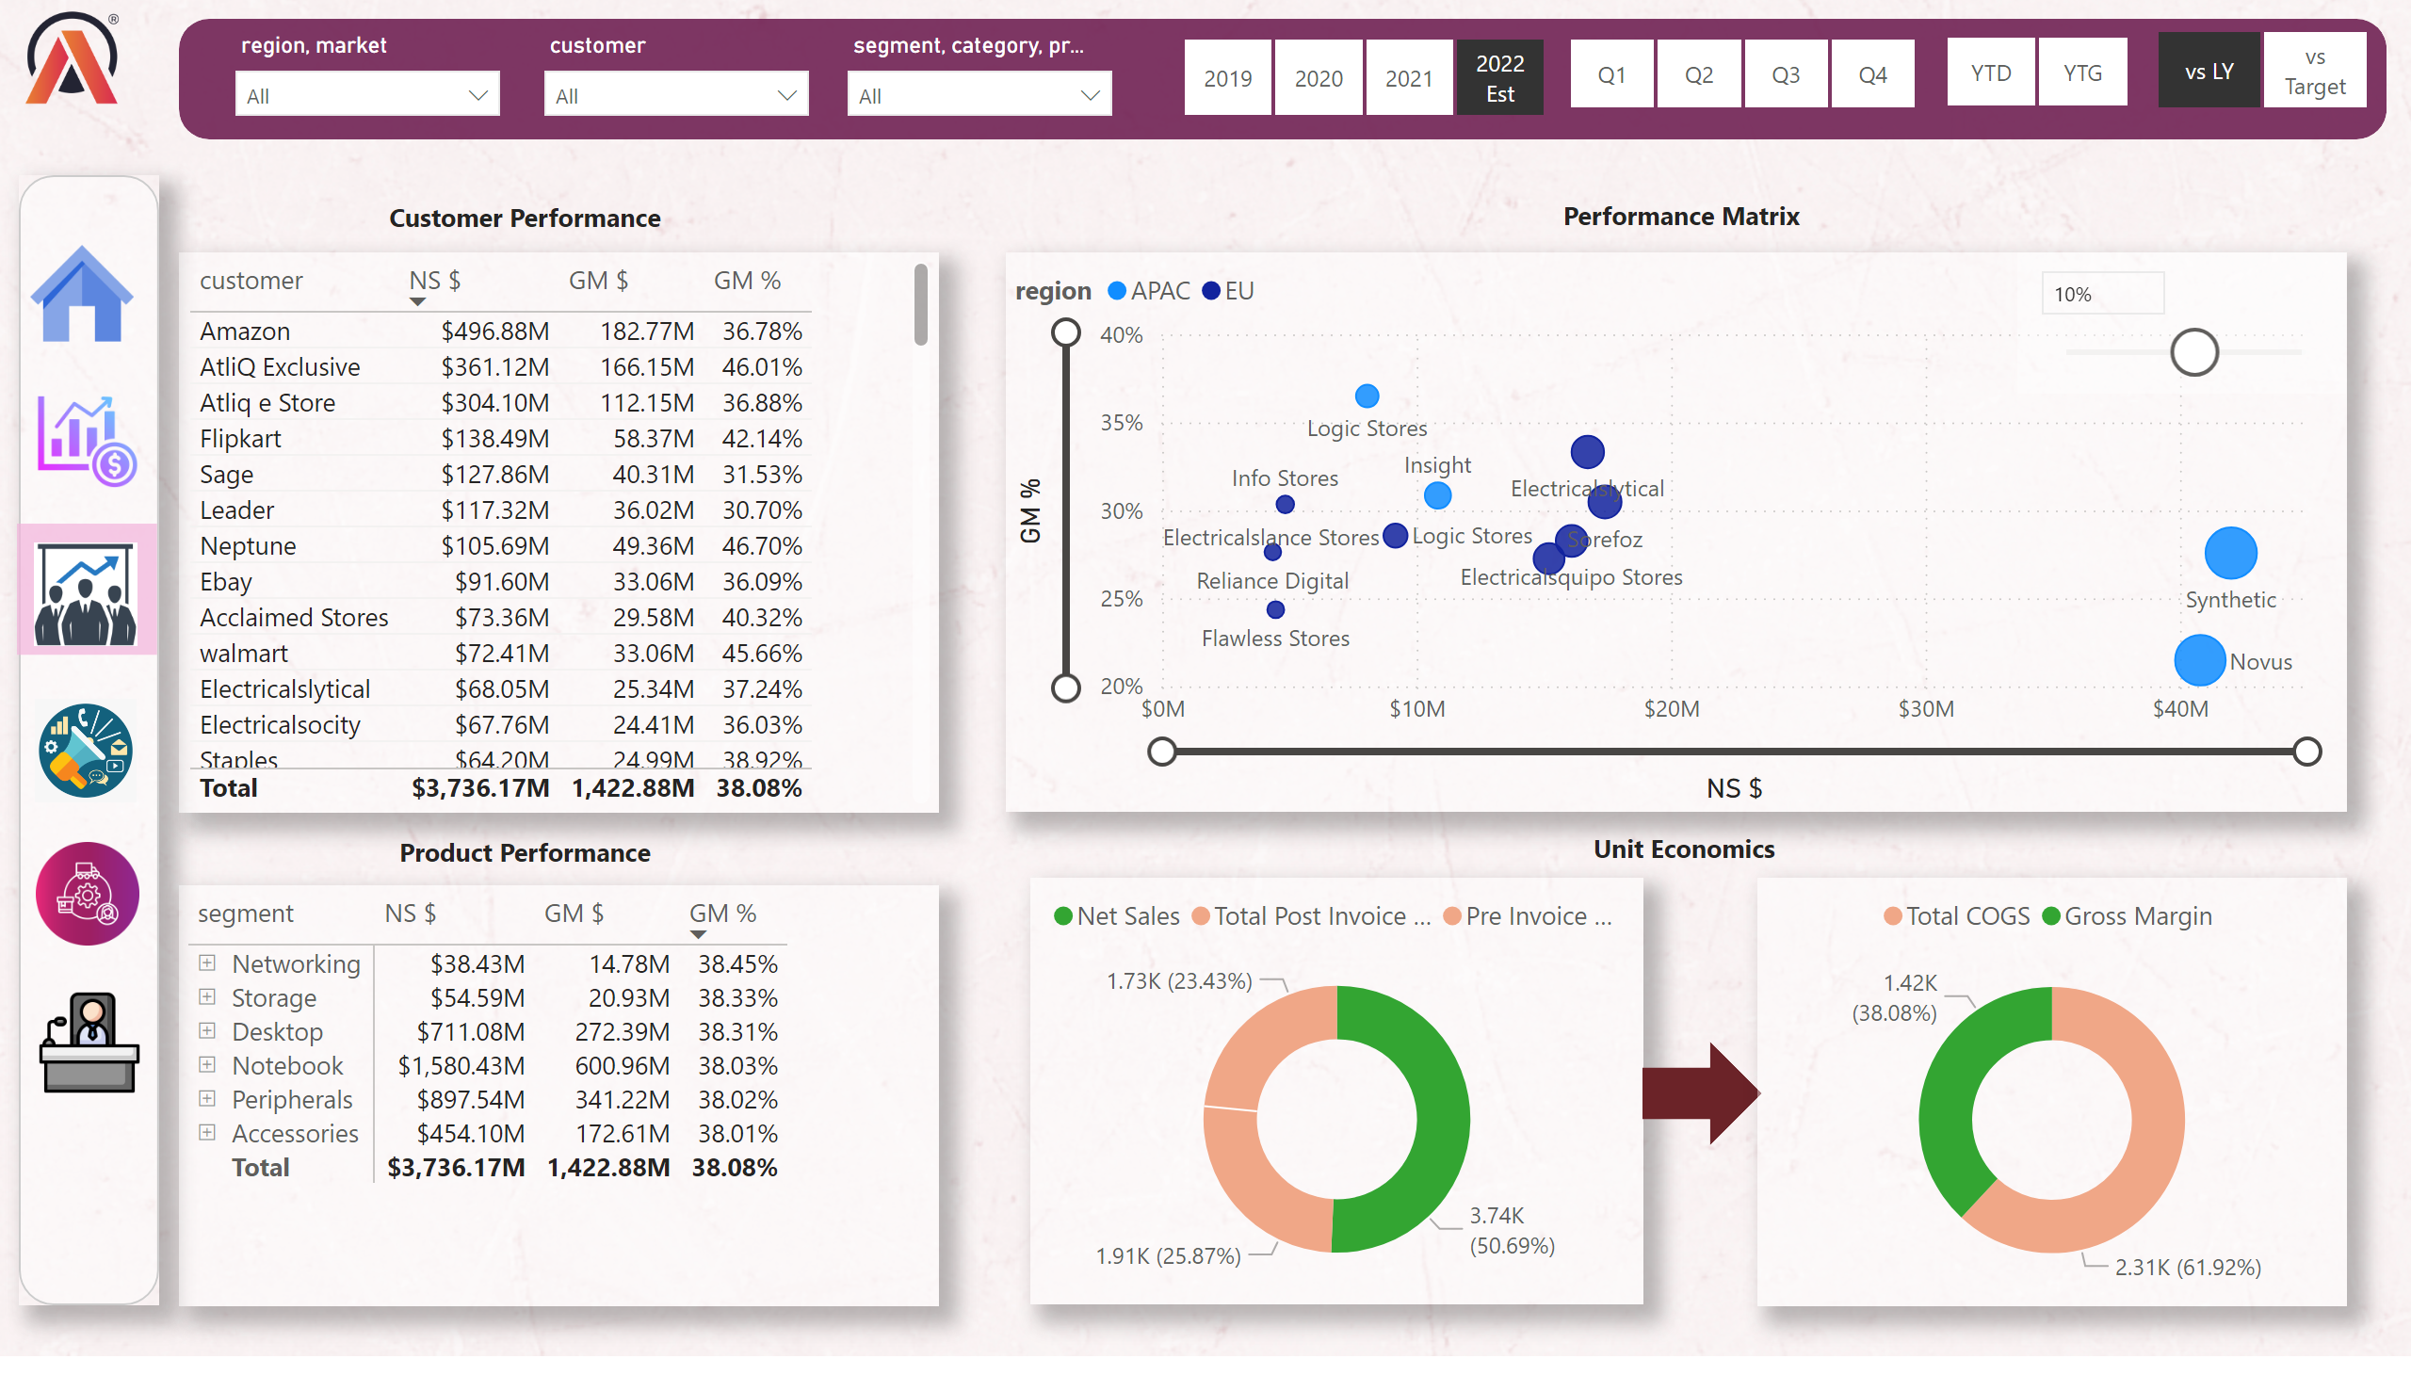
Sales View
Notes:
image
No alt text provided
shape
No alt text provided
textbox
No alt text provided
tableEx
No alt text provided
donutChart
No alt text provided
shape
No alt text provided
donutChart
No alt text provided
scatterChart
No alt text provided
pivotTable
No alt text provided
textbox
No alt text provided
textbox
No alt text provided
textbox
No alt text provided
slicer
No alt text provided
shape
No alt text provided
image
No alt text provided
image
No alt text provided
image
No alt text provided
image
No alt text provided
image
No alt text provided
image
No alt text provided
slicer
No alt text provided
slicer
No alt text provided
slicer
No alt text provided
slicer
No alt text provided
slicer
No alt text provided
slicer
No alt text provided
slicer
No alt text provided
shape
No alt text provided

Slide 4
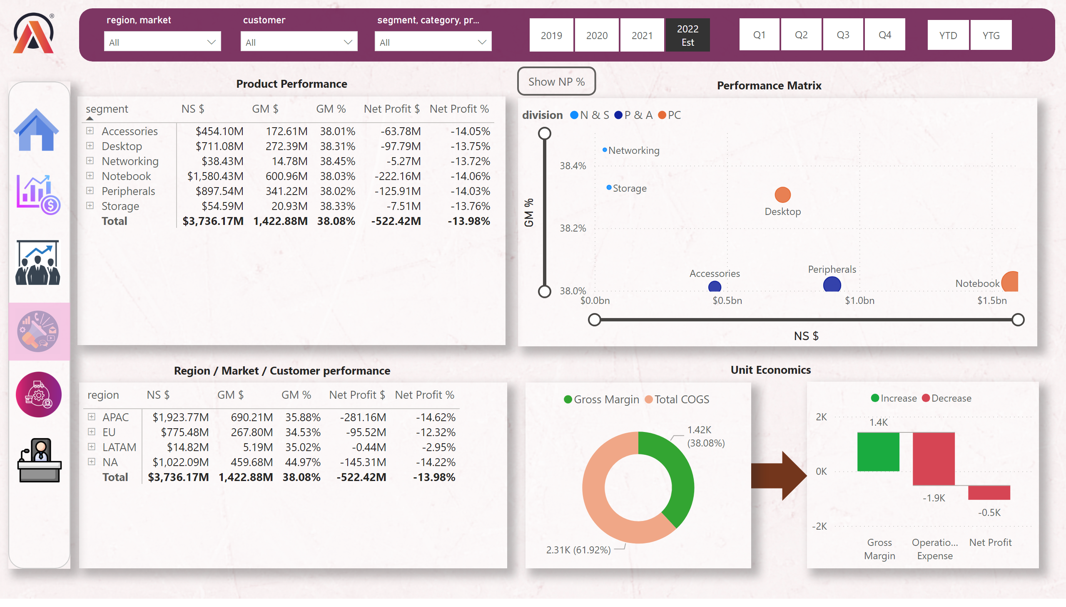
Marketing View
Notes:
image
No alt text provided
shape
No alt text provided
textbox
No alt text provided
shape
No alt text provided
donutChart
No alt text provided
GM % Visual
No alt text provided
NP % Button
No alt text provided
textbox
No alt text provided
textbox
No alt text provided
textbox
No alt text provided
waterfallChart
No alt text provided
pivotTable
No alt text provided
pivotTable
No alt text provided
actionButton
No alt text provided
scatterChart
No alt text provided
image
No alt text provided
image
No alt text provided
image
No alt text provided
image
No alt text provided
image
No alt text provided
image
No alt text provided
shape
No alt text provided
slicer
No alt text provided
slicer
No alt text provided
slicer
No alt text provided
slicer
No alt text provided
slicer
No alt text provided
slicer
No alt text provided
shape
No alt text provided

Slide 5
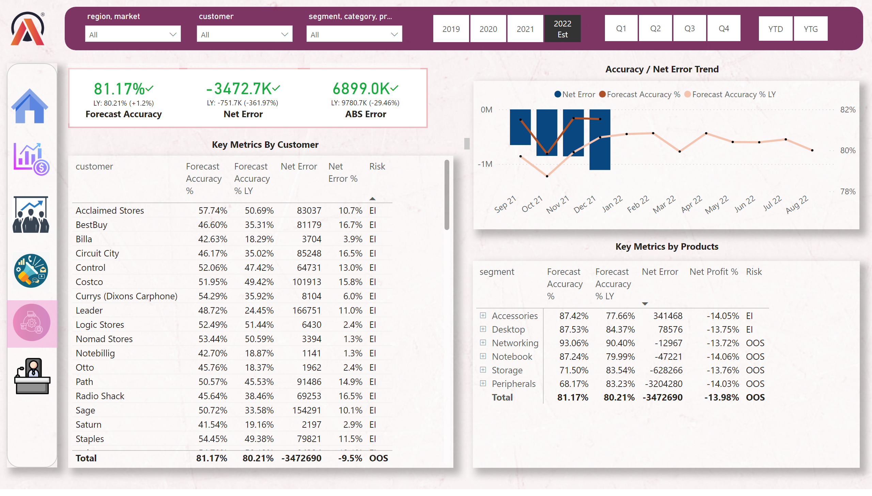
Supply Chain View
Notes:
Net Sales Performace Over Time
No alt text provided
textbox
No alt text provided
kpi
No alt text provided
textbox
No alt text provided
kpi
No alt text provided
textbox
No alt text provided
kpi
No alt text provided
textbox
No alt text provided
image
No alt text provided
shape
No alt text provided
tableEx
No alt text provided
pivotTable
No alt text provided
textbox
No alt text provided
textbox
No alt text provided
image
No alt text provided
image
No alt text provided
image
No alt text provided
image
No alt text provided
image
No alt text provided
image
No alt text provided
shape
No alt text provided
slicer
No alt text provided
slicer
No alt text provided
slicer
No alt text provided
slicer
No alt text provided
slicer
No alt text provided
slicer
No alt text provided
shape
No alt text provided
shape
No alt text provided

Slide 6
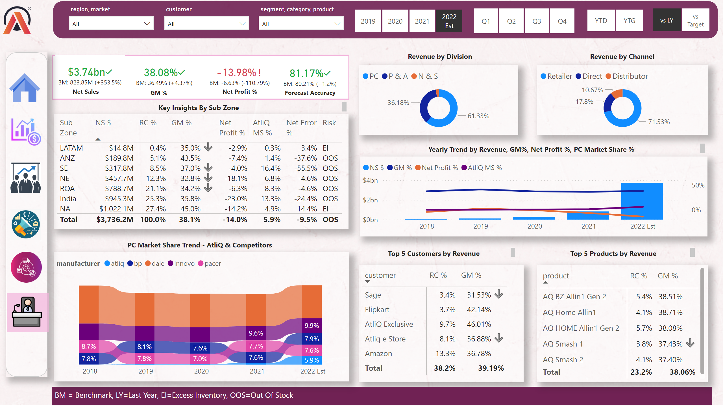
Executive View
Notes:
slicer
No alt text provided
slicer
No alt text provided
slicer
No alt text provided
pivotTable
No alt text provided
textbox
No alt text provided
slicer
No alt text provided
slicer
No alt text provided
slicer
No alt text provided
kpi
No alt text provided
textbox
No alt text provided
kpi
No alt text provided
textbox
No alt text provided
kpi
No alt text provided
textbox
No alt text provided
image
No alt text provided
shape
No alt text provided
shape
No alt text provided
textbox
No alt text provided
slicer
No alt text provided
card
No alt text provided
kpi
No alt text provided
textbox
No alt text provided
donutChart
No alt text provided
textbox
No alt text provided
donutChart
No alt text provided
textbox
No alt text provided
tableEx
No alt text provided
lineClusteredColumnComboChart
No alt text provided
textbox
No alt text provided
ribbonChart
No alt text provided
pivotTable
No alt text provided
textbox
No alt text provided
textbox
No alt text provided
textbox
No alt text provided
image
No alt text provided
image
No alt text provided
image
No alt text provided
image
No alt text provided
image
No alt text provided
image
No alt text provided
shape
No alt text provided
shape
No alt text provided

Slide 7
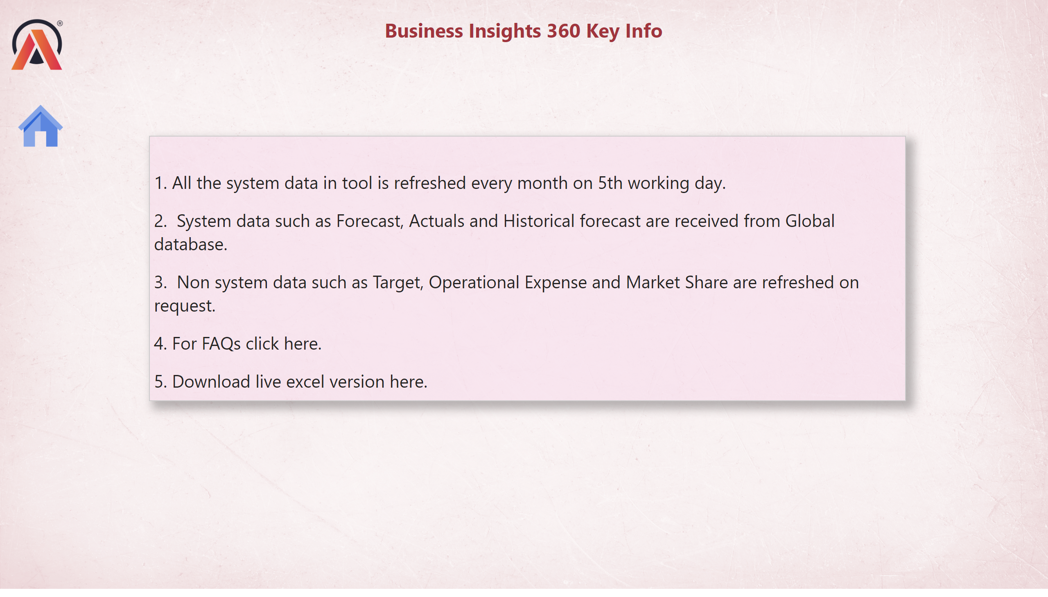
Info
Notes:
image
No alt text provided
textbox
No alt text provided
textbox
No alt text provided
image
No alt text provided

Slide 8
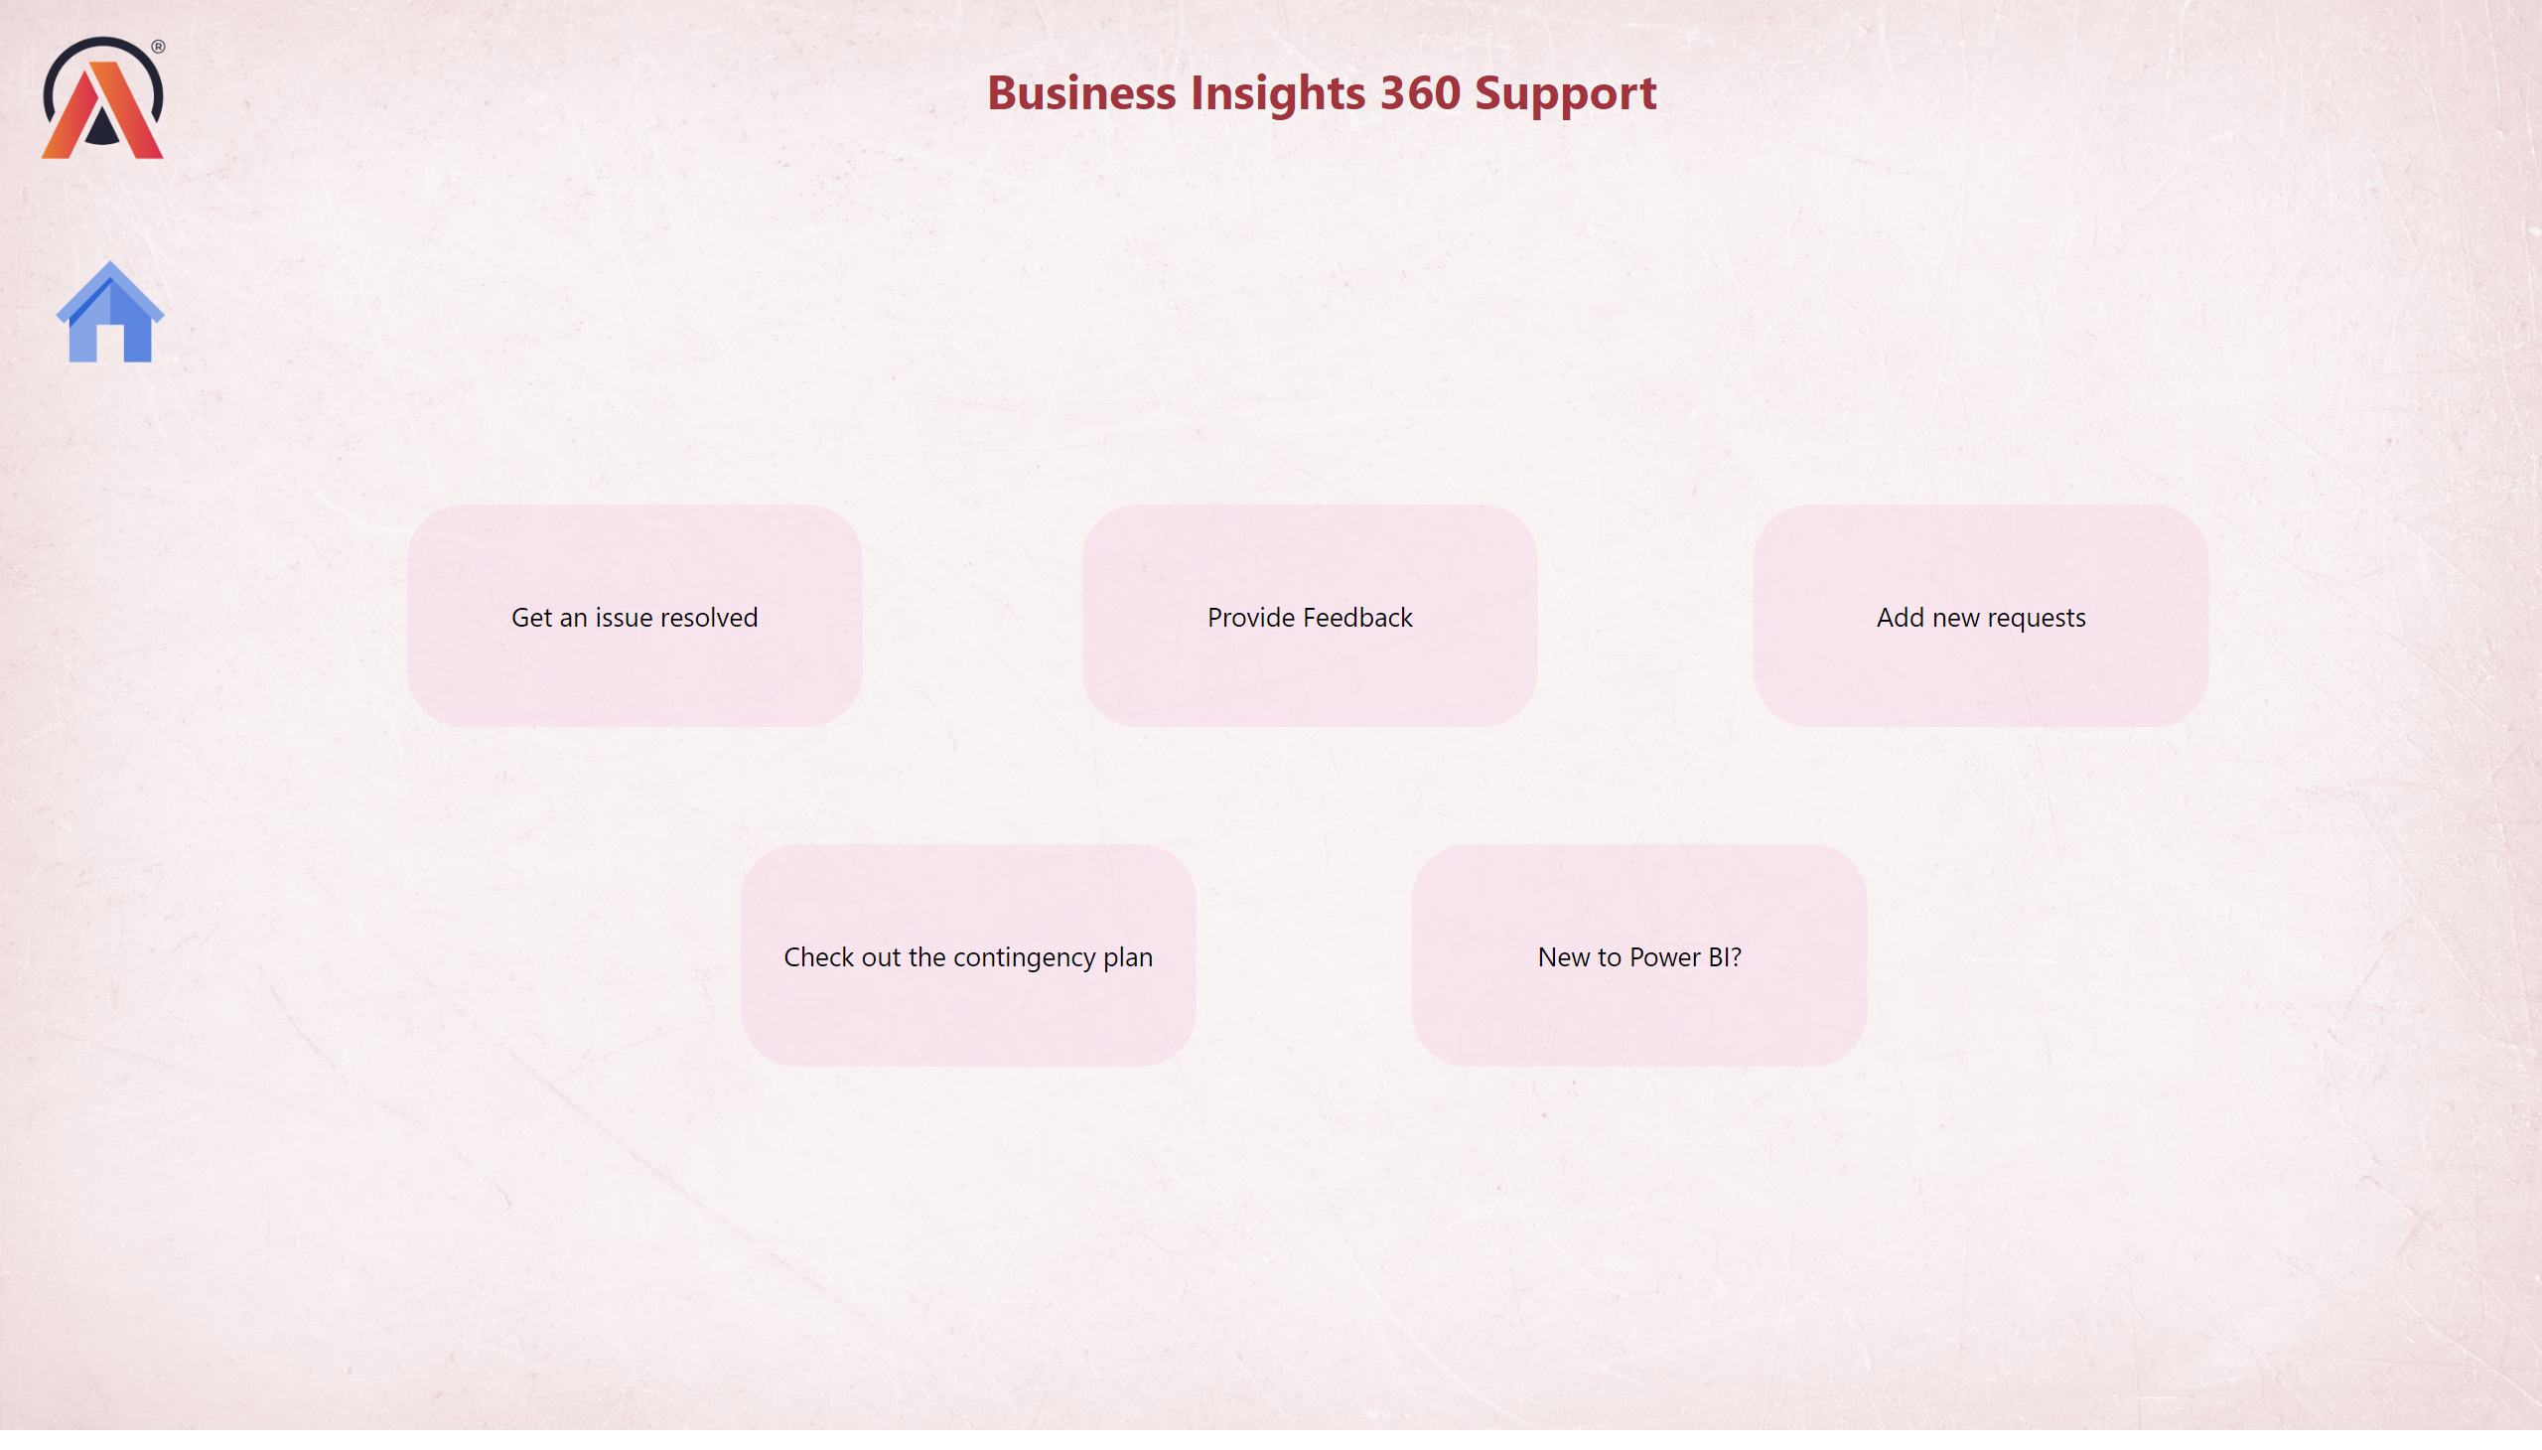
Support
Notes:
image
No alt text provided
textbox
No alt text provided
shape
No alt text provided
shape
No alt text provided
shape
No alt text provided
shape
No alt text provided
shape
No alt text provided
image
No alt text provided

